Slide 1
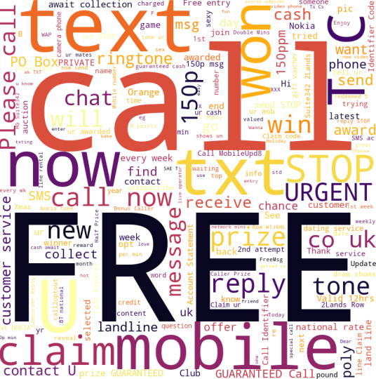
SPAM
Classifier
Team 13
Shreya Hunur
Rohit Yadav
Hashmitha Katta

Slide 2

Outline
Problem Statement
Objective
Dataset Overview
Project Life cycle
Model Summary
Findings and Suggestions
Conclusion

Slide 3
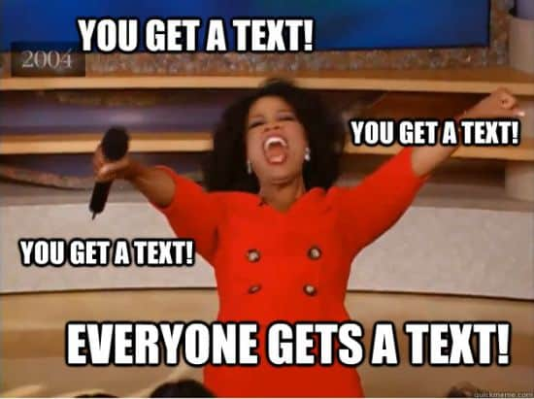
Problem Statement
Because of the rapid advancement of technology used by spammers, there is a need for classifiers that are more efficient, generic, and highly adaptive. Machine learning for spam classification is a critical area of study.

Slide 4

Objective
The proposed work investigates and identifies the use of various learning algorithms for classifying spam messages from genuine text messages.
We want to train the machine learning algorithm by providing the data set so that it can learn from it and draw conclusions on its own.
This is done to identify spam messages to reduce the number of frauds occurring around the world.

Slide 5
Dataset Overview

Slide 6
Project Life cycle

Slide 7
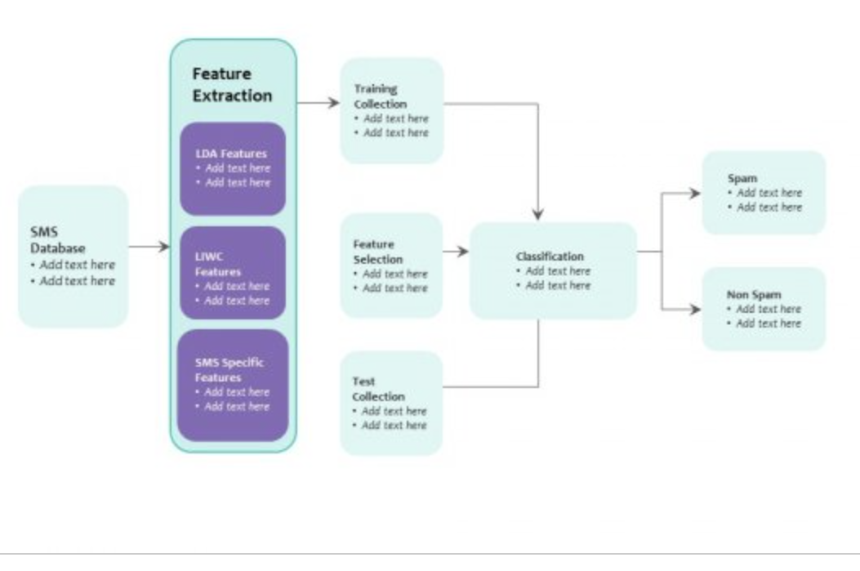
Note:Make something like this

Slide 8
Model Summary

Slide 9
Findings and Suggestions

Slide 10
Conclusion

Slide 11
Thank you !

